Slide 1


KRAKEN QGIS PLUGIN • USER MANUAL
Line of Sight (LOS) Analyzer
Interactive GIS clearance tool for evaluating signal propagation paths, terrain DEM profiles, building obstacles, and 3dB vertical beam tilt cones.
Elevation Source
RF Beam Analysis
Obstacle Detection
Terrain DEM + OSM Buildings
Mechanical & Electrical Tilt Cone
Auto Obstacle Coordinates
Kraken © 2026 | akanipatra@gmail.com

Slide 2

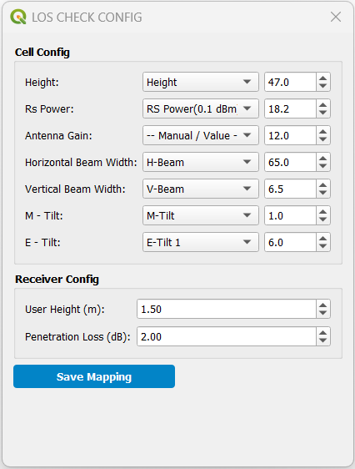
STEP 01 • PARAMETER SETUP
Configure Cell & Receiver Parameters
Map layer fields or assign manual RF values for accurate clearance computation.
Cell Antenna Mapping
Field Mapping: Map layer columns for Antenna Height, RS Power, Gain, H/V Beam Width, and Tilts.
Tilt Combination: Automatically sums Mechanical Tilt (M-Tilt) and Electrical Tilt (E-Tilt) for total inclination.
Manual Fallback: Input fixed spinbox values when layer attribute fields are missing.
Target Receiver (UE) Settings
User Height: Define UE receiver height above ground (default: 1.5m).
Penetration Loss: Set outdoor-to-indoor attenuation factor (dB).
Persistent Memory: Click "Save Mapping" to store defaults permanently in QGIS settings.
Kraken © 2026 | akanipatra@gmail.com

Slide 3
STEP 02 • MAP INTERACTION
Interactive 2-Point Ray Selection
Simple map canvas selection to trace line-of-sight signal paths instantly.
01
02
03
Select Cell Site
Drop UE Target Point
Cancel / Reset
Hover and click near any sector wedge on the map canvas. Cursor mode starts as Pointing Hand.
Click target point on map using Crosshair Cursor. Draws red vector line and places UE marker.
Right-click anywhere on canvas to cancel current selection and re-select Cell site.
Red rubber band line highlights direct path.
Clears active lines and UE markers.
Auto-identifies closest cell feature.
Red 'X' marker highlights target UE position.
Restores default selection state immediately.
Auto-populates RF dialog from feature attributes.
CURSOR FEEDBACK
CANVAS ACTION
SHORTCUT
Hand Cursor → Target Mode
Geodesic Sampling (10m step)
Right-Click to Abort
Kraken © 2026 | akanipatra@gmail.com

Slide 4

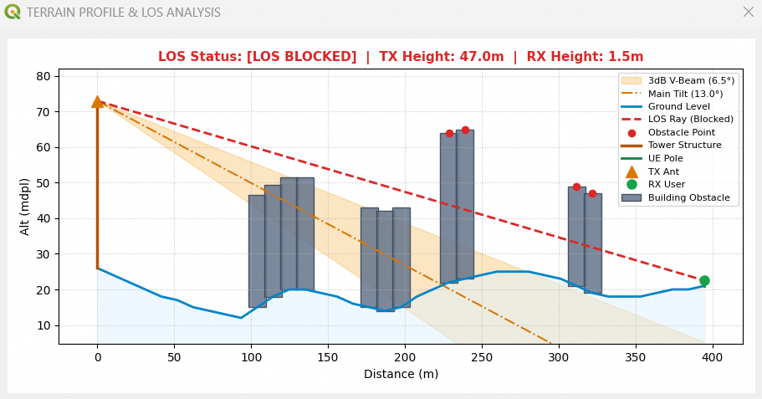
STEP 03 • PROFILE ANALYTICS
Elevation Profile & Obstacle Inspection
Comprehensive profile plot integrating terrain, structures, and antenna radiation patterns.
LOS Ray Status
Green dashed ray indicates LOS CLEAR. Red ray indicates LOS BLOCKED by terrain/building intersections.
Building Obstacles
Grey bars display structural height fetched live from OpenStreetMap Overpass API.
3dB Vertical Beam Cone
Amber shaded cone visualizes vertical 3dB beam coverage based on total tilt angle.
Kraken © 2026 | akanipatra@gmail.com

Slide 5
REFERENCE • BACKEND ARCHITECTURE
Elevation & Building Data Pipeline
Multi-tier failover mechanism ensures robust performance even without local raster DEMs.
Local Raster DEM
OpenTopoData API
OSM Overpass API
PRIMARY TERRAIN PROVIDER
FALLBACK TERRAIN PROVIDER
BUILDING HEIGHT ENGINE
Auto-detects DEM layers in active QGIS project.
Automatic online API fallback if local DEM is missing.
Queries OSM ways and relations for building polygons.
Supports local DEM, SRTM, and DEMNAS raster formats.
Uses Mapzen elevation dataset in 90-point chunk batches.
Multi-endpoint failover (France, Germany, Kumi).
High performance local elevation sampling.
Built-in HTTP rate-limit handling & failover.
Parses exact building heights or level counts (* 3.5m).
LATENCY
COVERAGE
ENDPOINTS
< 100ms (Offline)
Global Mapzen Dataset
3 Server Failover Cluster
Kraken © 2026 | akanipatra@gmail.com

